Slide 1
Morse Code Challenge 2 – Oct 17
Agenda
Coding Challenge: Morse Code
Complete by Today – Level 3
Complete by Tomorrow – Level 2 / 1 / R
Module Work
Upload Work Done So Far
Work on Past Modules ONLY WHEN Morse Code is Complete
Upcoming
Tomorrow : Morse Code Challenge – Last Day

Slide 2
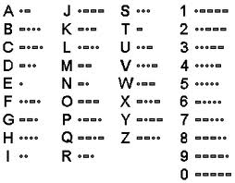
Morse Code

Slide 3
Sample Code
G R E G

Slide 4
Sample Code
G R E G
void loop () {
dash();
dash();
dot();
blank();
dot();
dash();
dot();
blank();
dot();
blank();
dash();
dash();
dot();
}

Slide 5
Sample Code
G R E G
void loop () {
dash();
dash();
dot();
blank();
dot();
dash();
dot();
blank();
dot();
blank();
dash();
dash();
dot();
}
void loop () {
dash(2);
dot(2);
dash(1);
dot(2);
dash(2);
dot();
}

